Slide 1
Dices, Analogy, Series Completion--
VIGNESH M

Slide 2
1.PIGEON:PEACE: : ?
(1) CROWN: HEAD (2) WHITE FLAG:SURRENDER (3) LAURELS: VICTORY (4) WAR: LIBERTY
2. Architect:Building: : Sculptor : ?
(1) Museum (2) Stone (3) Chisel (4) Statue
3.Writing:pen::?:needle
1)singing 2)stitching 3)carpenter 4)dancing

Slide 3
4.Physician:Treatment : :Judge : ?
(1) Punishment (2) Judgement (3) Lawyer ' (4) Court
5.CLOCK:TIME ::VECHICLE:?
1)ROAD 2)JOURNEY 3)FUEL 4)PASSENGER
6.WHEAT :BREAD ::?:BRICKS 1)CLAY 2)BUILDING 3)FIRE 4)CEMENT

Slide 4
Directions for Q7 -10: Choose the correct option.
7. QDXM : SFYN :: UIOZ : ?
(a) LPWA
(b) PAQM
(c) QNLA
(d) WKPA

Slide 5
8. QPS : TSV :: IHK : ?
(a) LKN (b) MKN (c) LOM (d) NQP
9. 6 : 60 :: 210 : ?
(a) 240 (b) 120 (c) 504 (d) 280
10. 215 : 35 :: 511 : ?
(a) 29 (b) 63 (c) 71 (d) 60

Slide 6
Directions for Q1 to Q4: From the given choices select the odd one out.
1. (a) NR (b) DW (c) FU (d) CX
2. (a) AA (b) BB (c) DDDD (d) EEEEE
3. (a) Q3N (b) P3N (c) Q4M (d) T2R
4. (a) SV2 (b) GI2 (c) BD2 (d) NR4

Slide 7
1. 1. Community 2. Locality 3. Family 4. Country 5. Person
(a) 4, 1, 2, 5,3 (b) 4, 2, 1, 3, 5 (c) 5, 3, 2, 1, 4 (d) 5, 3, 4, 2, 1
2. 1. Dress 2. Yarn 3. Cotton 4. Stitching 5. Plant
(a) 5, 3, 2, 4, 1 (b) 5, 3, 1, 4, 2 (c) 1, 2, 3, 4, 5 (d) 3, 5, 2, 1, 4
3. 1. Consultation 2. Disease 3. Recovery 4. Doctor 5. Medicine
(a) 2, 4, 5, 1, 3 (b) 2, 4, 1, 5, 3 (c) 2, 1, 5, 4, 3 (d) 2, 1, 4, 5, 3
4. 1. Office 2. Cabin 3. City 4. Desk 5. Building
(a) 2, 4, 5, 3, 1 (b) 2, 4, 1, 5, 3 (c) 4, 2, 1, 5, 3 (d) 4, 2, 5, 3, 1

Slide 8
2. 1. Dress 2. Yarn 3. Cotton
4. Stitching 5. Plant
(a) 5, 3, 2, 4, 1 (b) 5, 3, 1, 4, 2
(c) 1, 2, 3, 4, 5 (d) 3, 5, 2, 1, 4

Slide 9
3. 1. Consultation 2. Disease 3. Recovery
4. Doctor 5. Medicine
(a) 2, 4, 5, 1, 3 (b) 2, 4, 1, 5, 3
(c) 2, 1, 5, 4, 3 (d) 2, 1, 4, 5, 3

Slide 10
4. 1. Office 2. Cabin 3. City
4. Desk 5. Building
(a) 2, 4, 5, 3, 1 (b) 2, 4, 1, 5, 3
(c) 4, 2, 1, 5, 3 (d) 4, 2, 5, 3, 1

Slide 11
1. A decision has to be taken on the basis of the given conditions. There are two cases based on the same set of conditions. Take a decision for both the cases and mark the correct answer for each.
Following are the conditions imposed by an employer for providing Rs.3 lacs as Leave Travel Concession to the employees.
The employees:
1. Must have performed 2 journeys in a block of 4 calendar years (Current block: 2010-2013).
2. Must have made only 1 trip in 1 year.
3. Must have made one trip within India, while the other could have been outside India.
4. Should have made a trip with less than 5 people.
5. The total cost of both the trips should not have exceeded Rs.7 lacs.

Slide 12
However,
(a) if the employees fulfil all conditions except (4) then he/she would get R.2.5 Iacs as concession.
(b) if the employees fulfil all conditions except (5) then he/she would get Rs.2 lacs as concession.
How much concession would be given to the given employee? (The case is presented as on 1.12.2012)
Rajesh, along with his wife and 2 kids went for vacations within India. He made his first trip in January, 2010 and second in May, 2010. The total cost of both the trips was Rs.2.5 lacs.
(a) Employee would not be given any concession
(b) Employee would be given Rs.3 lacs concession
(c) Employee would be given Rs.2 lacs concession
(d) Employee would be given Rs.2.5 Iacs concession
(e) Data insufficient

Slide 13
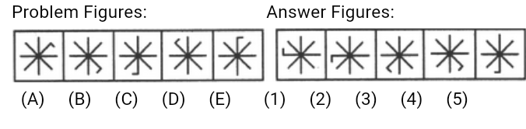

Slide 14
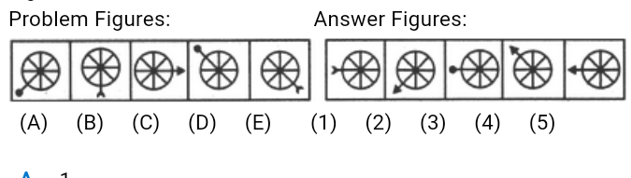

Slide 15
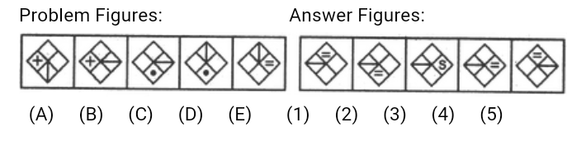

Slide 16
1. X, U, S, P, N, K?
(1) I (2) M (3) L (4) Q (5) None of these
2. FDS, JHW, NLA,?
(1) QND (2) RQD (3) RPE (4) SOF (5) None of these
3.D-4, F-6, H-8,J-10, ?
(1) K-12 (2) M-14 (3) L-12 (4) M-13 (5) None of these
4.3F, 6G, 11I, 18L,
(l) 21O (2) 25N (3) 27 P (4) 27Q (5) None of these

Slide 17
.bc-b-c-ac-ab-ac
(l)aabcb (2)bbacb (3)cabbc (4)ccabc (5) None of these
-bdbc-d-c-bd-cd
(l)dbdcd (2)dcbcd (3)bcdcb.(4)cdbcb (5) None of these
ef-h-gfe-hef-ehgefg-
(1)ehhfg (2)ggfhe (3)ghgfh (4)egffh (5) None of these

Slide 18
aac-bba-cc-baa-cb-
(l)cabcb (2)bacab (3)aabcb (4)ccbcb
adb-ac-d-bcda-bcac-d
(l)bacbd (2)cbadb (3)dbacb (4)acbda (5) None of these

Slide 19
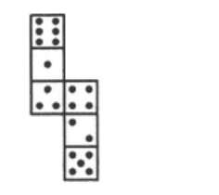
14.How many dots lie opposite to the face having three dots, when the given figure is folded to form a cube?
a. 2 b. 4 c. 5 d. 6

Slide 20
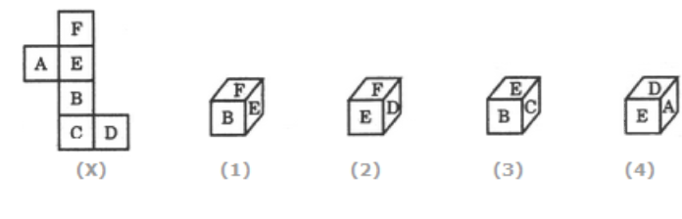
15.Choose the box that is similar to the box formed from the given sheet of paper (X).
a. 1 only b. 2 only c. 1 and 3 only
d 1, 2, 3 and 4 only

Slide 21
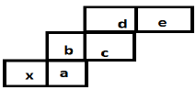
If the given Sheet is folded to form a cube, which side will be opposite to X?

Slide 22
THANK YOU

